Slide 1
Recap of Class 2
Introduction to congressional structure (including committees) and procedure
  E.g., “a Congress,” session, appropriations, authorizations, ranking member, reconciliation, joint v. concurrent resolutions
Elements of legislative history
How “vetogates” serve as impediments to translating majority sentiment into actual legislation
  Structural advantage of well-organized interests
  Structure of elections (e.g., gerrymandering)
  Limited role of courts in policing legislative process (Rucho)
Limits on torts and contract law to protect public against certain harms
Classic rationales for regulation in general and objections often made to particular regulations

Slide 2
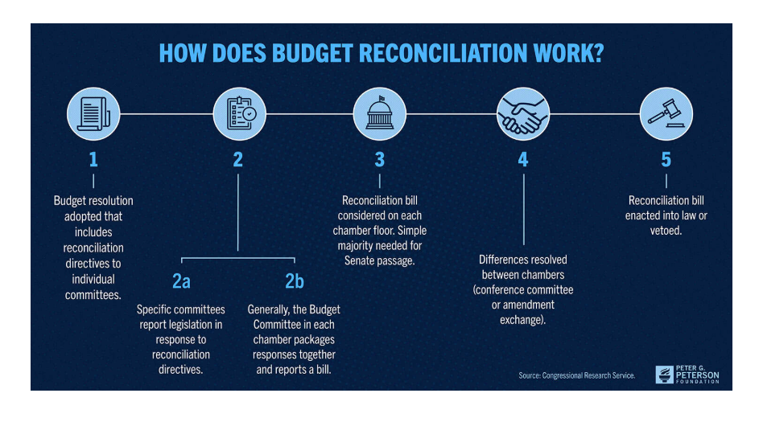
Another Look at Reconciliation

Slide 3
The Path to Administration
Is there a problem warranting government response?
Would private law remedies suffice? (Liability rule + judicial enforcement at the behest of private parties)
Should legislature prescribe conduct rules?
Should an agency be put in charge?
What tools should it have?

Slide 4
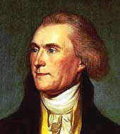
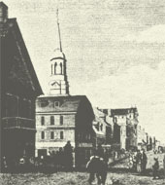
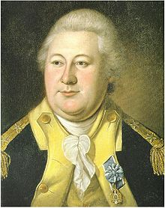
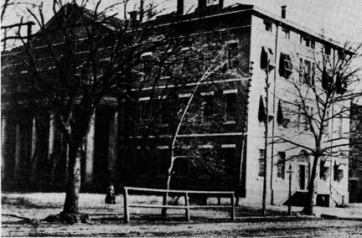
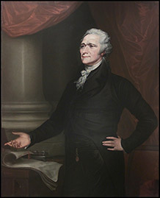
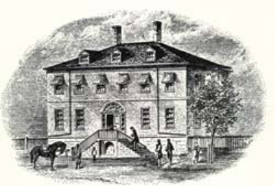
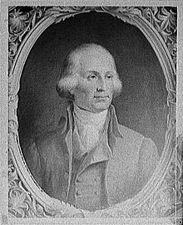

Agencies From the Outset
Foreign Affairs War
Treasury Post Office

Slide 5
Why Agencies?
Advantages
Problems
Focused and sustained attention to a specific agenda
Can amass expertise and educated judgment over time
Allows Congress to set action in motion earlier rather than later
Institutional efficiency
Transparency and accountability
Not as directly accountable to the electorate
Susceptible to capture
Develop institutional interests related more to self-preservation than public interest mission
Challenging to coordinate

Slide 6
Spurts of Growth
Founding Period
Maturing of the National Economy
The New Deal (and the Labor Movement)
60’s-70’s: Responses to Social Movements (Civil Rights, Consumer, Environmental, Women’s)
Twenty-First Century Crises (9/11, Recession, Health Care)

Slide 7
Many Shapes of Agencies
Department of the Treasury
  Single head
  Multiple internal office and agencies (IRS)
  High visibility
National Labor Relations Board
  Multiple heads
  Regional offices but no sub-agencies
  Makes policy chiefly through case-by-case administrative adjudication
National Institutes of Health
Coast Guard
Administrative Conference of the United States

Slide 8
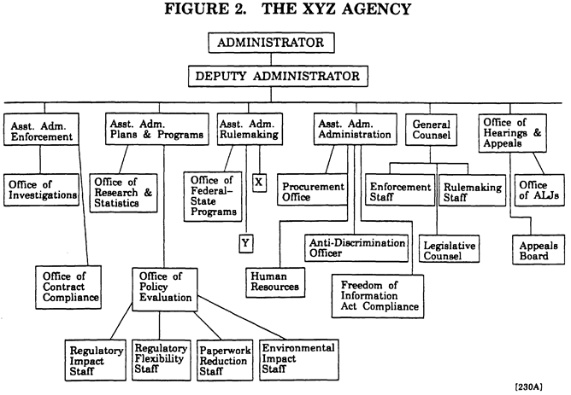
Bureaucracy and Coordination

Slide 9
The Foundational Problem of Administrative Law
Discretion

Slide 10
Levels of Discretion
“Mow my lawn every Saturday to a height of 3/4 inches, using an electric rotary mower.”
“Mow my lawn every week, as needed.”
“Take care of my yard.”
“Improve my property.”

Slide 11
Principal-Agent Problem
Agencies are called agencies because they are carrying out directions promulgated by their “principal,” which supposedly is Congress
Every statute creates a clear or fuzzy “zone of discretion”
  The agent may not know how the principal wants discretion to be exercised
  The agent may be exercising discretion at a time much later than when the statute was enacted
Who is “the principal” anyway?
  The enacting Congress?
  The sitting Congress?
  The President?
  Regulated parties?
  The courts?

Slide 12
Lawyers . . .
Justice Department
  Attorney General
  Solicitor General
  Office of Legal Counsel
Agency general counsels
Lawyers within offices, bureaus

Slide 13
And Where They Look for Law
U.S. Constitution and cases interpreting it;
Organic agency statutes;
Authorization and Appropriations acts;
Generic statutes, such as the Administrative Procedure Act (APA), which apply to all bodies falling within each statute’s definition of “agency”;
judicial opinions
opinions of the U.S. Attorney General and OLC
presidential executive orders and other directives; and
agency law in the form of “circulars,” directives, manuals, precedential adjudicative orders, or rules (as they may appear in the Federal Register or, as codified, in the Code of Federal Regulations).

Slide 14
Systems Design: The Challenges
Consistency with the rule of law.
Process fairness.
Instrumental rationality.
Cost-effectiveness.
Political accountability.
Interest representation.
Consistency with general public values (nondiscrimination, efficiency, environmental sensitivity, etc.).

Slide 15
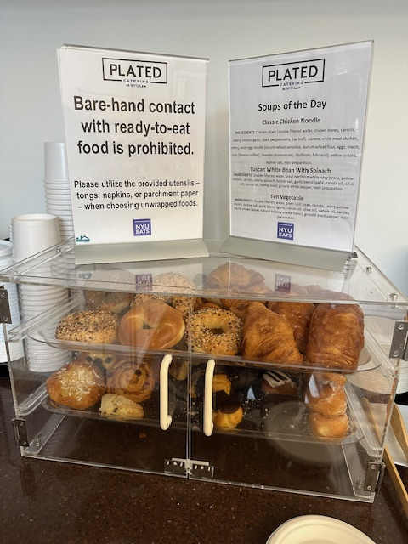
Statutory Context

Slide 16
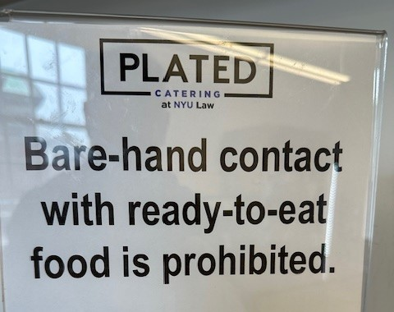
The statutory command: Must I eat any pastry I take with a knife and fork?

Slide 17
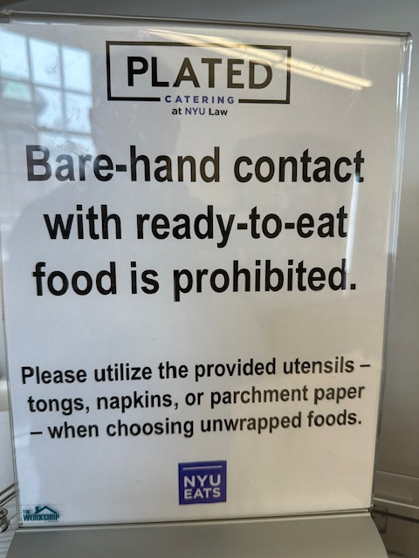
Does the additional text limit the scope of the rule or simply illustrate one possible application?

Slide 18
Complications of Statutory Construction (1)
Interpretation (meaning) v. construction (how to apply)
  Even if we know an “ambulance” = “vehicle,” does ban on “vehicles” apply to ambulances?
Complexity Source 1: Properties of language: ambiguity, vagueness (see RAK at 15)
  Unforeseen applications
  Intentional delegation to executive branch
  Coalitions fudge areas of disagreement
  Inevitable properties of language

Slide 19
Complications of Statutory Construction (2)
Complexity Source 2: Institutional Roles
  Katzmann: Judges should be “faithful to the work of the people’s representatives memorialized in statutory language” (105)
  What does that mean? Faithful to Congress’s text? To its purposes?
  What if Congress has assigned a task to an agency that has already interpreted the statute a certain way? Should a judge defer to the agency?
  Should processes of enactment affect interpretation?

Slide 20
Structuring Your Analysis
What triggered the lawsuit?
What is the actual text in dispute?
What are the contending interpretations/constructions?
Why do the contending interpretations/constructions make a difference?
Which interpretation or construction does the court pick?
Why?

Slide 21
Approaches to Interpretation
Intentionalism
Purposivism
Textualism
Common characteristics
  Largely same tools, but different emphasis
  All start from premise of legislative supremacy

Slide 22
The Hierarchy of the Federal Courts
Supreme Court of the United States: nine Justices; discretionary review by certiorari; final word on federal law
U.S. Courts of Appeals: 13 circuits; appeals as of right, heard in three-judge panels
D.C. Circuit hears a large share of agency review cases; Federal Circuit is subject-matter based
U.S. District Courts: 94 trial courts; fact-finding and initial review of agency action
Specialized and Article I tribunals: Tax Court, Court of International Trade, bankruptcy courts
Why it matters: many statutes route agency review straight to the courts of appeals
Circuit splits shape agency practice until the Supreme Court resolves them

Slide 23
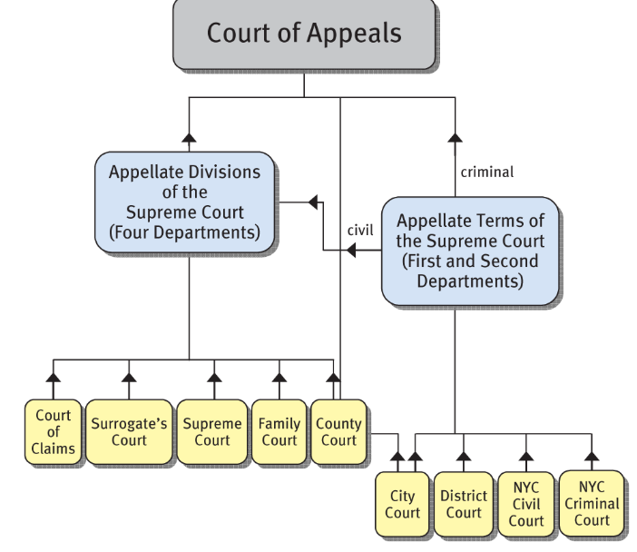
Hierarchy of NYS Courts

Slide 24
Riggs v. Palmer
(N.Y. Court of Appeals 1889)
Statutes of NY (“No will in writing, except in the cases hereinafter mentioned, nor any part thereof, shall be revoked or altered otherwise, etc.”) prescribe conditions for the finality of a will
  “[C]ases hereinafter mentioned” do not include “should an heir murder the testator” [only fraud, duress, or incapacity]
Three arguments for implying this “case” is also an exception
  Absurdity of contrary result
  Contrary to policy of the statute (preserving the peace)
  Common law disfavors profiting from one’s own wrong
So, why the dissent?
  Violates legislative supremacy
  Violates policy to honor testator intent (daughters get too much?)
  Amounts to the imposition of an ex post facto penalty

Slide 25
Riggs v. Palmer Hypos
Background: Grandfather leaves small legacies to 2 daughters, residuum to his grandson; state law makes wills final except in cases of fraud, duress, incapacity
Actual: Grandson kills grandfather; NY disallows inheritance
Hypo 1: Grandson kills grandfather’s best friend, but not discovered until after grandfather’s death
Hypo 2: Grandson kills one of the daughters, but not discovered until after grandfather’s death
  Does court have power to deny him the woman’s legacy as part of the residuum?
  Would court disallow his inheritance altogether?

Slide 26
Church of the Holy Trinity v. U.S. (1892)
Be it enacted by the senate and house of representatives of the United States of America, in congress assembled, that from and after the passage of this act it shall be unlawful for [any person, company, partnership, or corporation], [in any manner whatsoever], [to prepay the transportation, or in any way assist or encourage the importation or migration,] [of any alien or aliens, any foreigner or foreigners,] [into the United States, its territories, or the District of Columbia,] [under contract or agreement, parol or special, express or implied,] [made previous to the importation or migration of such alien or aliens, foreigner or foreigners,] [to perform labor or service of any kind] [in the United States, its territories, or the District of Columbia.]
  A Seattle-based construction company prepays for ocean transport of Chinese workers to work as lumberjacks on Canadian forest land leased to the company?
  A NY restaurant agrees to reimburse for ocean transport of English men and women as far as Nova Scotia if they agree to work in the restaurant; the workers must fend for themselves getting from Nova Scotia to New York?

Slide 27
Holy Trinity - 2
Facts: Church of the Holy Trinity contracted with Rev. E. Walpole Warren, of England, to be its pastor; statute makes exceptions to its terms, but not for clerics
Why does majority infer an exception?
  Title of the Act: “An act to prohibit the importation and migration of foreigners and aliens under contract or agreement to perform labor in the United States, its territories, and the District of Columbia.”
    Labor = manual labor according to “common understanding” and “ordinary meaning”

Slide 28
Holy Trinity - 3
  Aim of act = protect wages of U.S. workers
    Illuminated by reference to the events preceding the legislation
  Legislative history:
  Petitions and testimony refer to “cheap, unskilled labor” (the “mischief” to be remedied)
  Senate report
  Congressional record

Slide 29
Holy Trinity - 4
Public policy
  [N]o purpose of action against religion can be imputed to any legislation, state or national, because this is a religious people. This is historically true. From the discovery of this continent to the present hour, there is a single voice making this affirmation. . . . These, and many other matters which might be noticed, add a volume of unofficial declarations to the mass of organic utterances that this is a Christian nation.

